Slide 1
Diabetes
Children & Adolescents
Adelina C. Salinas, MSN, APRN, FNP-BC, CDE
Gregorio Rodriguez, MSN, RN, CDE

Slide 2
Adelina Salinas, MSN, APRN, FNP-BC, CDE Conflicts of Interest – None to disclose Gregorio Rodriguez, MSN, RN, CDE Conflicts of Interest – None to disclose

Slide 3
Incidence of Diabetes in Youth
SEARCH for Diabetes in Youth study
Based on data collected from 2002-2012
Type 1 DM: 11,245 youths (0-10 years of age) identified
Estimated incidence rates increase by 1.4% annually
From 19.5 cases per 100,000 youths per year in 2002-2003
To 21.7 cases per 100,000 youths per year in 2011-2012

Slide 4
Incidence of Diabetes in Youth
SEARCH for Diabetes in Youth study
Based on data collected from 2002-2012
Type 2 DM: 2,846 youths (0-19 years of age) identified
Estimated incidence rates increase by 7.1% annually
From 9.0 cases per 100,000 youths per year in 2002-2003
To 12.5 cases per 100,000 youths per year in 2011-2012

Slide 5
Prevalence of Diabetes in Youth
Increasing prevalence of both type 1 and type 2 diabetes
Rise in obesity
Population growth
Hispanic boys show the strongest associations with future type 2 diabetes

Slide 6
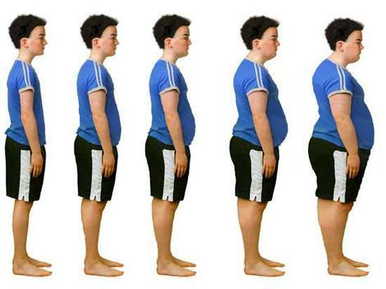
Obesity
From 2011 – 2014 for children and adolescents:
Prevalence of obesity was 8.9% among 2 to 5 year olds
Prevalence of obesity was 17.5% among 6 to 11 year olds
Prevalence of obesity was 20.5% among 12 to 19 year olds

Slide 7
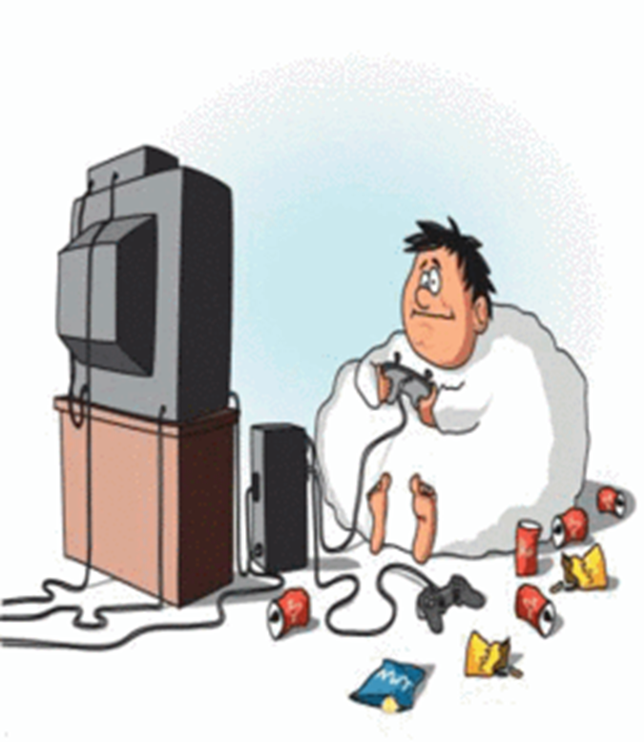

Slide 8
Diabetes mellitus
An illness where the body:
Doesn’t produce insulin or
Doesn’t use it adequately
Insulin
The hormone needed to transform food into energy
Acts like a key so that sugar can enter cells
Produced by the pancreas

Slide 9
Type 1 Diabetes
Autoimmune disease
Other immune disorders associated: celiac disease, Addison's disease (adrenal insufficiency), hypothyroidism
Hyperglycemia is secondary to insulin deficiency
Destruction of pancreatic beta cells
Age and treatment is no longer used as treatment criteria
Juvenile diabetes or IDDM

Slide 10
Type 1 Diabetes
Etiology is used to classify type of diabetes
70% of type 1 is diagnosed before age 30
Onset at any age

Slide 11
Type 1 Diabetes
Diagnoses
Usually acute onset
Usually clear cut but must have A1C ≥ 6.5% documented
Some may present with DKA (Diabetic Ketoacidosis)

Slide 12
Type 1 Diabetes
Diagnoses
Most children present with c/o frequent urination, thirst, sudden unexpected weight loss
Parents may say:
Child going to sleep with bottles of water because of unquenchable thirst
Unexplained weight loss in the 2-3 weeks prior to diagnoses

Slide 13
Type 1 Diabetes
Monitoring
Studies show frequency of monitoring has been strongly associated with glycemic control
ADA (American Diabetes Association) recommends a minimum of 3 blood glucose measurements per day
Ketone Testing- general recommendation when BG (Blood Glucose) is above 300 mg/dl and during illness
Fluids and/or insulin are often required to clear ketosis

Slide 15
Screening Children for Type 2 Diabetes and Pre-diabetes
ADA recommends:
Screen all children who are overweight and have any 2 of the following risk factors
Family history of type 2 diabetes in first- or second-degree relative
Belonging to a high-risk ethnic group
Acanthosis nigricans
Hypertension
Hyperlipidemia
Polycystic ovarian syndrome (PCOS)
Screen every 2 years starting at 10 years of age or onset of puberty if before 10 years

Slide 16
Type 2 diabetes
In children, almost always associated with obesity
Often associated with metabolic disorders
Hypertension, dyslipidemia, acanthosis nigricans, PCOS
Initially treated with weight loss and oral hypoglycemic medications
Can progress to requiring insulin

Slide 17
Type 2 Diabetes
Diagnoses
A1C ≥ 6.5
Acute symptoms and plasma glucose ≥ 200 mg/dl
Fasting plasma glucose ≥ 126 mg/dl
2-hour OGTT ≥ 200 mg/dl
Same as adults

Slide 18
Type 2 Diabetes
Monitoring blood glucose
Vary depending on physician and current pharmacologic therapy
May vary by child depending on age and other factors
A1C target <7.0%
Individualized target
Blood glucose in most patients: 70 - 130 mg/dL

Slide 19
Complications
Heart disease and stroke
Kidney or renal disease
Vision complications
Neuropathy and nerve damage
Complications of the feet
Complications of the skin

Slide 20
Insulin Therapy
Basal insulin
Long acting insulin
Detemir, glargine, degludec
Provides insulin coverage for baseline metabolic activity
Usually should not change much day to day
Menses, infections, exercise days

Slide 21
Insulin Therapy
Bolus insulin
Short or rapid acting insulin
Regular or lispro, aspart and glulisine
Lasts a few hours
Covers the insulin required for a meal
It is also used to quickly correct hyperglycemia

Slide 22
Insulin Therapy
Type 1 DM:
Usually will need basal insulin once or twice a day
Will need a short or rapid acting insulin before each meal
Scheduled dose (eg. 5 units before each meal)
Correctional dose or “sliding scale” based on SMBG (Self Monitoring Blood Glucose)
Carbohydrate counting

Slide 23
Insulin Therapy
Type 2 DM:
Lifestyle modification and weight loss
Oral medications (Metformin)
Maybe some long acting (basal) insulin once a day
Children rarely will need basal + bolus

Slide 24
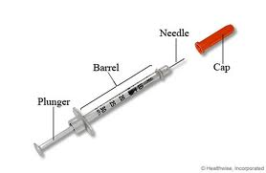
Basics of Insulin Therapy

Slide 25
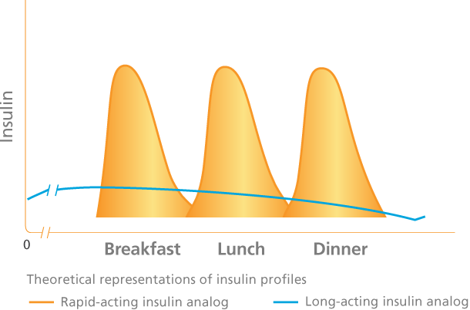
Basics of Insulin Therapy
MDI: multiple daily injections
Continuous subcutaneous insulin infusion (‘pump’)

Slide 26
Hyperglycemia
Growth spurts
Sick days
Stress
Inadequate amounts of insulin account for 30% of DKA cases in type 1 diabetes
Insulin omitted to control weight
Psychological problems complicated by eating disorders
Insulin avoided to prevent hypoglycemia
Insulin omitted to avoid inconvenience or embarrassment of injecting in public
Using insulin that is outdated or inaccurately stored

Slide 27
Hyperglycemia
Guide to treatment in the DMMP (Diabetes Medical Management Plan)
Call healthcare provider and notify parents
Monitoring can be periodically. Student is allowed to return to class room for instruction and return to nurse’s office for monitoring.
Allow fluids to be with student in the class
Include
Frequent monitoring q 2-3 hours
Checking for ketones
If positive
Extra fluids, usually 1-2 eight oz of sugar free fluids q 2 hours
May require extra insulin to prevent DKA

Slide 28
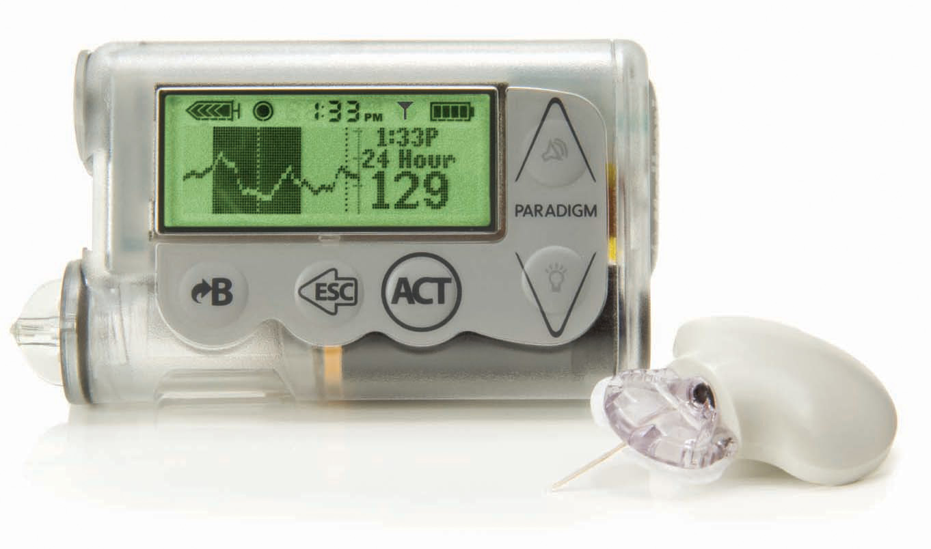
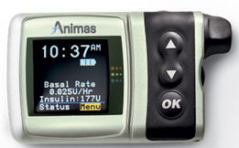
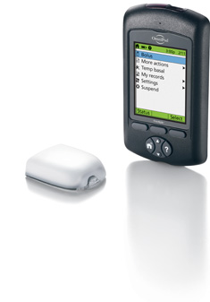
Basics of Insulin Pump Therapy
Subcutaneous infusion aka “pump”

Slide 29
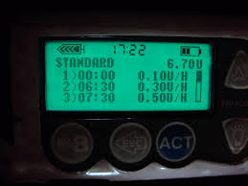
Basics of Insulin Pump Therapy
Basal:
Rate of insulin per hour
Can be set differently per hour
Can have more than one basal program

Slide 30
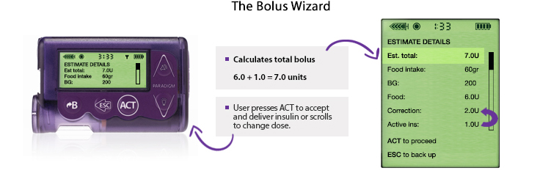
Basics of Insulin Pump Therapy
Bolus
Carbohydrate ratio
Calculated amount of insulin given for 1 g of carbohydrates
Correction
Based on “sensitivity” or amount the blood sugar is predicted to drop with 1 unit of insulin
Similar to “sliding scale”
www.professional.medtronicdiabetes.com

Slide 31
Basics of Insulin Pump Therapy
The user will need to tell the pump:
How many grams of carbohydrate will be eaten
What the blood sugar is
Many glucometers now can communicate with pumps
Pump users need to know how to count carbohydrates
They will need to check their blood glucose many times a day, usually a minimum of 3-4 times.

Slide 32
Healthy Eating
There are 3 kinds of foods that provide energy for our body to function
Carbohydrate – WILL increase blood glucose
Protein – Will NOT increase blood glucose
Fat – Will NOT increase blood glucose

Slide 33
Carbohydrates
Body’s main energy source
The 3 sources of carbs are:
Starch: grains, pasta, bread, cereal, starchy vegetables (beans, corn, potato & rice)
Fruit: all fruits
Milk: milk and yogurt

Slide 34
How Do You Count Carbs?
Carb counting helps people with diabetes plan their meals and snacks
Some people with diabetes count carb choices and others count grams of carb
1 carb choice = 15 grams of carb

Slide 35
How much Carbohydrates is needed?
There is not one diet for all
Your school Registered Dietitian (RD) can help
Child’s age
Gender
Activity level
If physically active, he or she may need more carbs

Slide 36
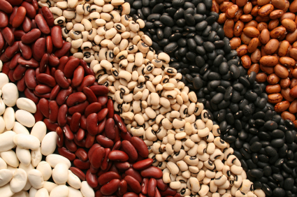
Serving Sizes
15 grams of Carbohydrates:
1 slice of bread
6” Tortilla (flour or corn)
½ cup oatmeal
1/3 cup rice
½ cup beans
½ cup corn
1 cup milk
6oz plain yogurt
1 small potato

Slide 37
A Healthy Meal Plan
Focuses on whole grains, fruits, vegetables
Fat-free or low-fat milk and milk products
Includes lean meats, poultry, fish, beans, eggs and nuts
Is low in saturated fats, trans fats, cholesterol, salt (sodium) and added sugars

Slide 38
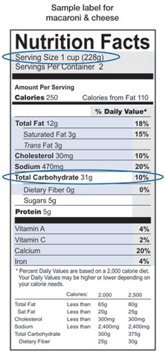
Reading Nutrition Labels
Serving size
2. Total carbohydrate
Dietary fiber can be subtracted from total carb
Sugar Alcohol: subtract half from total carb

Slide 39
Nutrition
Check with your RD or school food service director for accurate carb amounts
Students should be allowed to participate in school parties or events with food
Students with type 1 diabetes should cover for carbs on most occasions. Specified in diabetes medical management plan (DMMP)
Students with type 2 diabetes usually will not need coverage unless specified by provider in DMMP
There are not any “bad” foods

Slide 40
Physical Activity
Many benefits including weight management
Type 1 are increased risk for hypoglycemia
Accommodations to participate in sports should be made by school
Rehabilitation Act of 1973- Section 504
More frequent monitoring (before, during, and after exercise) may be necessary to avoid hypoglycemia
General guideline is that a snack containing 10 to 30 g of carbohydrate should be consumed for every 30 to minutes of moderate physical activity

Slide 41
Physical Activity
Blood glucose readings taken at the start and end of an exercise session allow the individual to gauge the amount of change happening during physical activity and to determine if additional carbohydrates are needed
Example:
If the BG usually drops 30 to 40 mg/dL during physical activity and the goal is to stay at 90 mg/dL, a pre-exercise snack should be eaten for readings below 130 mg/dL
Use carbs that are slowly absorbed such as whole grains, whole fruits, yogurt, or snack bars
Do not use juice, glucose tablets or regular soda

Slide 42
Physical Activity
Anticipate intensity of physical activity
Have a fast acting source of glucose to treat hypoglycemia
Coach or other staff present should be trained on signs and symptoms of hypoglycemia and what to do
If on a pump, provider should specify on DMMP how to adjust basal rate or if an extra snack should be taken and no adjustments to pump

Slide 43
Advanced Carbohydrate Counting
Method used to determine bolus insulin dose needs
Humalog, Novolog, Apidra, or Regular Insulin
Used in place of correctional scale or fixed insulin dose
Must be familiar with carbohydrate counting

Slide 44
Insulin to Carb Ratio:
Tells you how many carbs are covered by one unit of bolus insulin
May be different at each meal time
Calculated by child’s HCP
Ex: 1:15
You will need one unit of fast acting insulin for every 15 grams of carbs consumed
If eating 45 grams of carbs you would need 3 units of bolus insulin

Slide 45
Correction/Sensitivity Factor:
Tells you how many points one unit of insulin will lower blood glucose
May be different throughout the day
Calculated by child’s HCP
Target blood glucose usually 120 mg/dl
Ex: 1:50
If your target BG is 120 mg/dl and your current BG is 250 mg/dl you are 130 points above target
One unit will lower BG 50 points, therefore 130 divided by 50=2.6. You would need 3 units of bolus insulin to correct BG

Slide 46
PUTTING IT ALL TOGETHER! YOUR TURN
Terry’s blood glucose before lunch in 170 mg/dL. She will be having 30 grams of carbohydrate for lunch. How many units of pre-meal insulin will Terry need?
ICR 1:15
ISF 1:50
Target BG 120 mg/dl
Answers
1 unit to correct blood glucose
2 units to cover carbs
Total dose of 3 units pre meal

Slide 47
INSULIN PUMPS

Slide 48
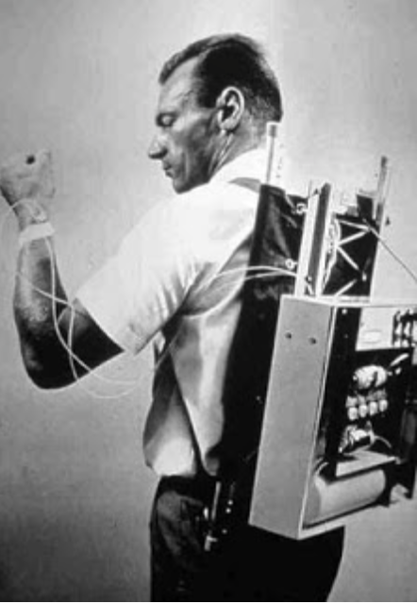
First Insulin Pump invented in 1963 by Dr. Arnold Kadish

Slide 49
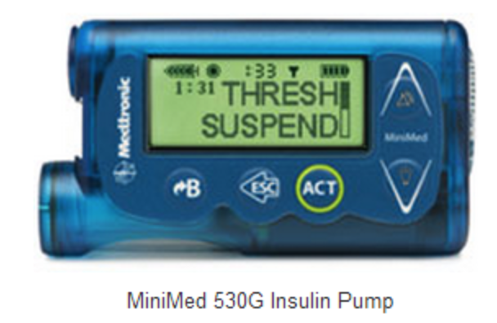
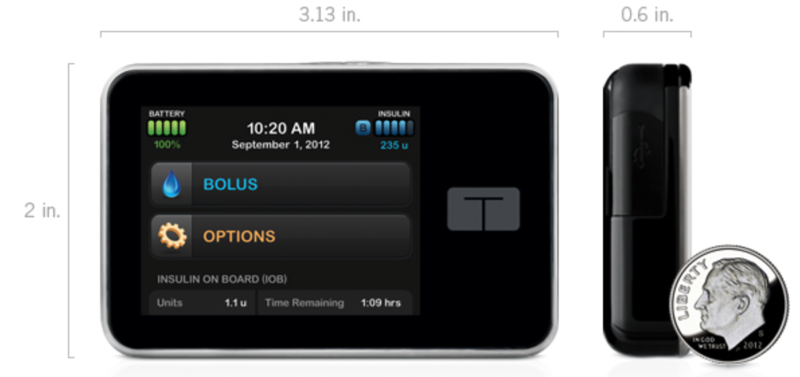
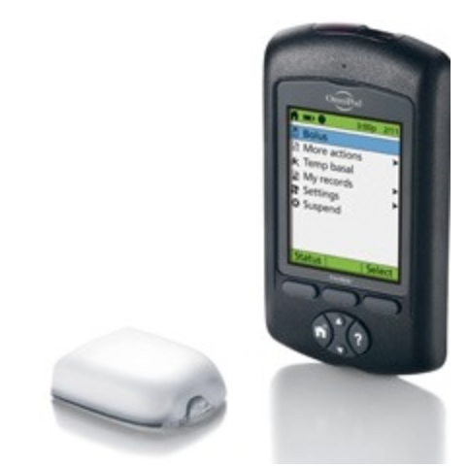
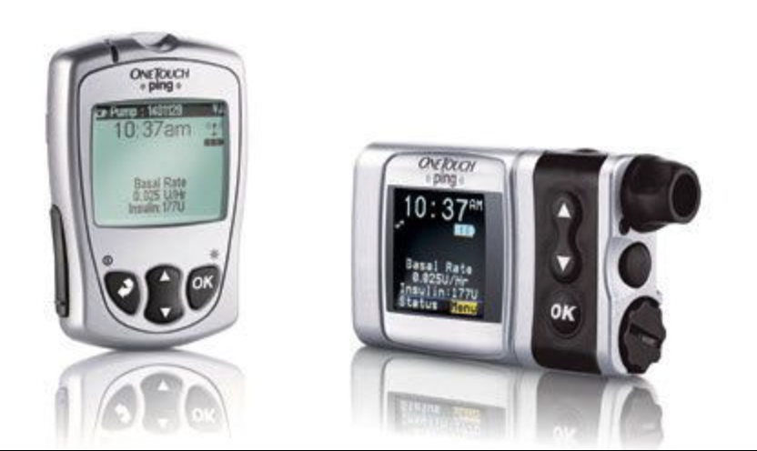
Insulin Pumps

Slide 50
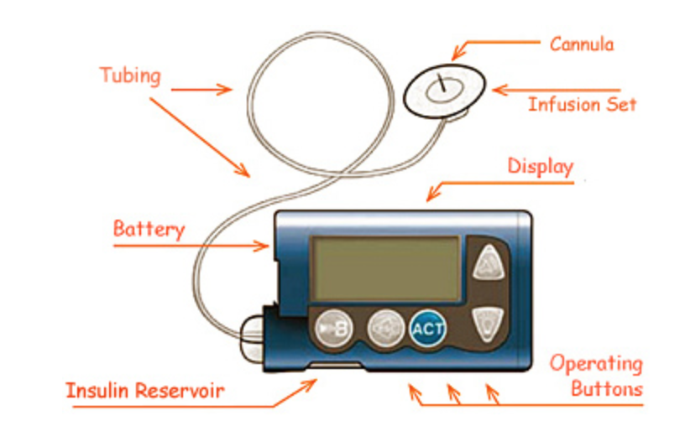
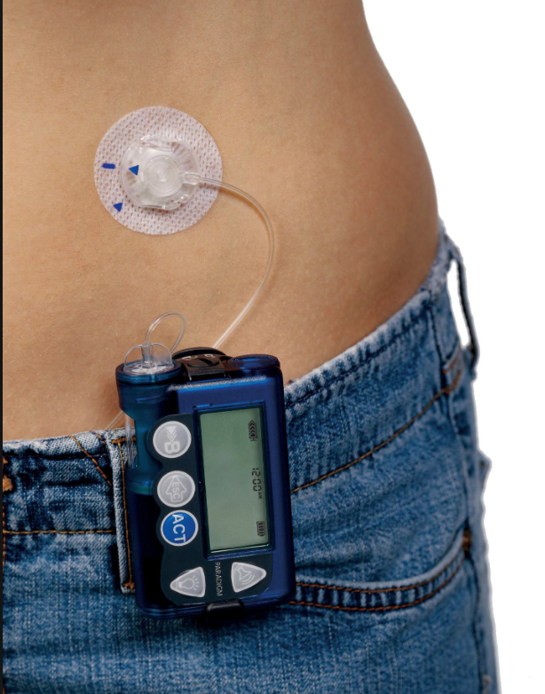
Insulin Pump Therapy
Pumps mimic normal insulin physiology with a consistent basal rate and appropriate bolus doses for meals
This leads to tighter glucose control and smaller variation
For patients, the pumps can be liberating, requiring far fewer injections than MDI

Slide 51
Insulin Pump Therapy Settings
Settings
The insulin used are rapid acting, and the reservoir typically holds 200-300 units of insulin (2-3 mls)
Basal Rate → units of insulin/hour
Carbohydrate ratio → units of insulin required to cover X (grams) of carbohydrate
Insulin Sensitivity factor → unit of insulin required to lower X (mg/dl) of glucose
Blood glucose target

Slide 52
Hyperglycemia on Insulin Pump Check Tubing
Air Bubbles
Air Spaces
Clumps
Blood
Persistent blood in the cannula (if visible) or tubing necessitates infusion set replacement because blood is taking the place of insulin in the system and may contribute to clogging. If a patient bleeds profusely on cannula insertion, he or she should remove the cannula and re-attempt the set insertion with a new infusion set at a different site.

Slide 53
Check Insertion Site
Redness
Pain
Swelling
Discomfort
Patients should be taught to watch for erythema, itching, edema, warmth, pus and blistering at the infusion site
Site change every 3 days
Risk for infection
Increase blood glucose

Slide 54
Check for…
Leaking
Feel
Look
Smell

Slide 55
Insulin Pump Problems
Can involve any portion of the device
Batteries can fail
Tubing can easily kink or crack
Reservoirs can leak or not be replenished on time
SubQ needles can frequently slip out
Be sure to check ALL sections of the insulin pump!!

Slide 56
Complications from Insulin Pump Use
Local reaction to tape and adhesives
Local allergic reactions to insulin preparations
Lipodystrophy → degeneration of adipose tissue
Cellulitis

Slide 57
Prevent Diabetic Ketoacidosis
Within a couple of hours
Insulin spoilage
Device failure
Unplanned disconnection

Slide 59
Continuous Glucose Monitor Sensors (CGMS)

Slide 61
CGMS
Tracking and trending information/pattern management
Immediate feedback on how changes in diet, exercise , and insulin affect glucose levels
Reduction in hypo- and hyper-glycemia
Helps patient assess magnitude of glucose excursions
Education Emphasis: Proficiency
The system must be calibrated in stable conditions
There is a physiologic latency between interstitial and capillary glucose
Risk of stacking and hypoglycemia
Capillary glucose must be used for therapeutic decisions
Alarm burnout

Slide 62
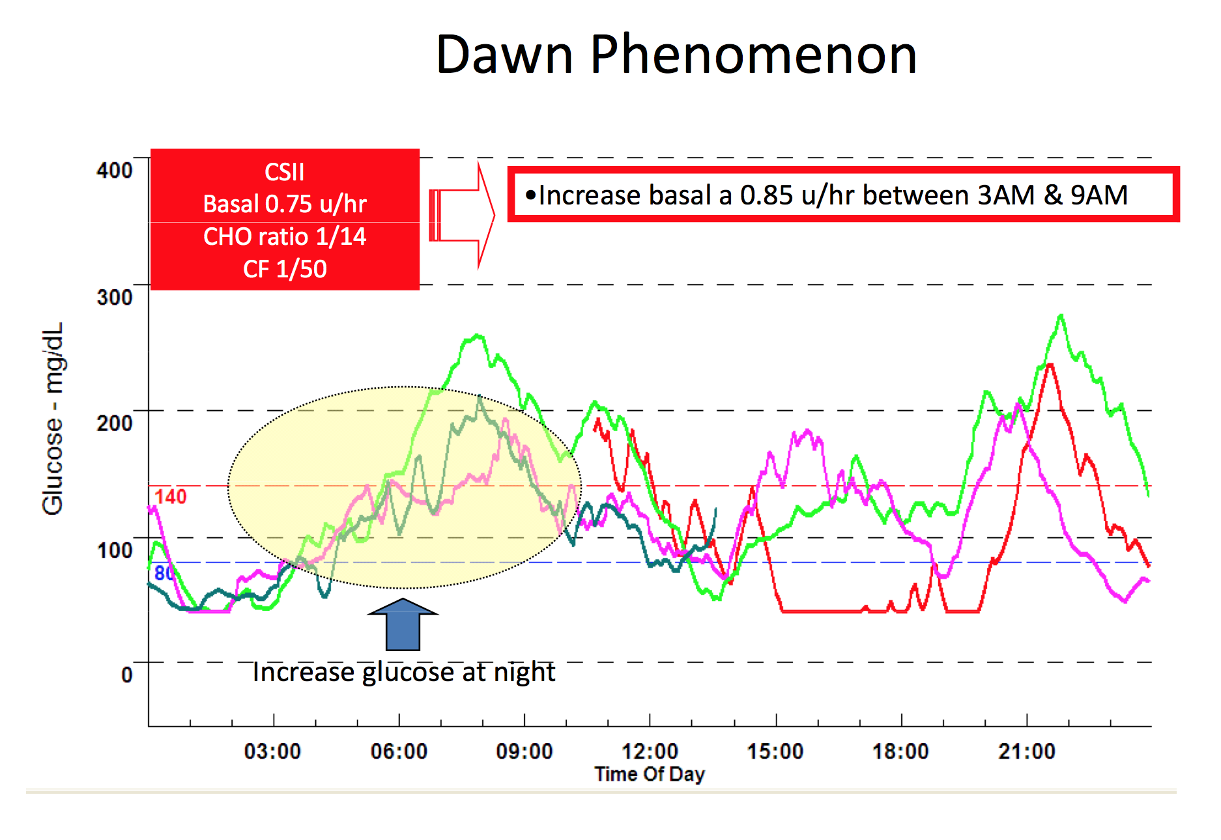

Slide 64
Survival Skills
Testing blood glucose and urine for ketones
Measuring and administering insulin
Insulin actions
Meal planning
Prevention, recognition, and treatment of hypoglycemia

Slide 65
Emotions
Individuals will often grieve the loss of their health
Parents will grieve the loss of their healthy child
In type 1 diabetes, parents must be reassured there was nothing they could have done to prevent the disease
Parents and family need to understand the difference in pathophysiology and treatment of type 1 and type 2 diabetes

Slide 66
Diabetes and school
ADA recommends the following related to school staff training:
All school staff members who have responsibility for a student with diabetes should receive training that provides a basic understanding of the disease and know who to contact in an emergency
A small group of school staff members should receive training from a school nurse or another qualified health care professional such as a physician or a nurse with expertise in diabetes, and also in student-specific routine and emergency care
The school nurse or another qualified health professional should be involved with training of appropriate staff and providing ongoing professional supervision and consultation regarding routine and emergency care of students with diabetes
http://www.diabetes.org/living-with-diabetes/parents-and-kids/diabetes-care-at-school/school-staff-trainings/?loc=diabetesorg

Slide 67
Diabetes Medical Management Plan
DMMP
Developed and signed by the student's personal health care team and parent/guardian with the specific needs of an individual student in mind
Checking blood glucose
Continuous Blood Glucose Monitoring
Hypoglycemia Treatment
Hyperglycemia Treatment
Insulin Therapy
Insulin Pump Therapy
Meal Plan
Physical Activity & Sports
Examples at:
http://www.diabetes.org/living-with-diabetes/parents-and-kids/diabetes-care-at-school/written-care-plans/diabetes-medical-management.html

Slide 68
Lifestyle Modifications
Exercise:
Moderate-intensity physical activity 30-45 minutes, 5 days/week
Diet:
Increased fiber, vegetables
Reduce intake of saturated fat, trans fat, cholesterol
Weight loss:
7-10% weight loss for obese individuals
Goal of BMI <25 kg/m2
Notes:
Lifestyle modifications that emphasize reduction of established risk factors useful intervention for pediatrics
Main therapeutic goals in obese children and adolescents regardless of a metabolic syndrome diagnosis.

Slide 69
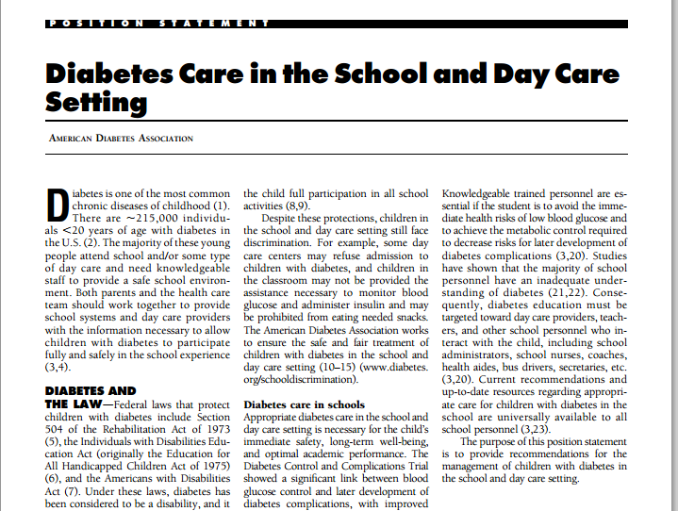
http://www.diabetes.org/assets/pdfs/schools/ps-diabetes-care-in-the-school-and-daycare-setting.pdf

Slide 70
http://www.diabetes.org/living-with-diabetes/parents-and-kids/diabetes-care-at-school/

Slide 71
http://www.diabetes.org/living-with-diabetes/parents-and-kids/diabetes-care-at-school/school-staff-trainings/training-resources.html

Slide 72
Thank You! Any Questions?

